Slide 1
Streams and Files
In java

Slide 2
Streams
Streams facilitates transporting data from one place to another. Different streams are needed to send or receive data through different sources, such as to receive data from keyboard, we need a stream and to send data to a file, we need another stream.
With out streams it is not possible to move data in java.

Slide 3
streams
Streams can be categorized as:
Input streams
Output streams.
Input streams are the streams which receive or read data.
Output streams are the streams to send or write data.
All streams are represented by classes in java.io(input-output) package.

Slide 4
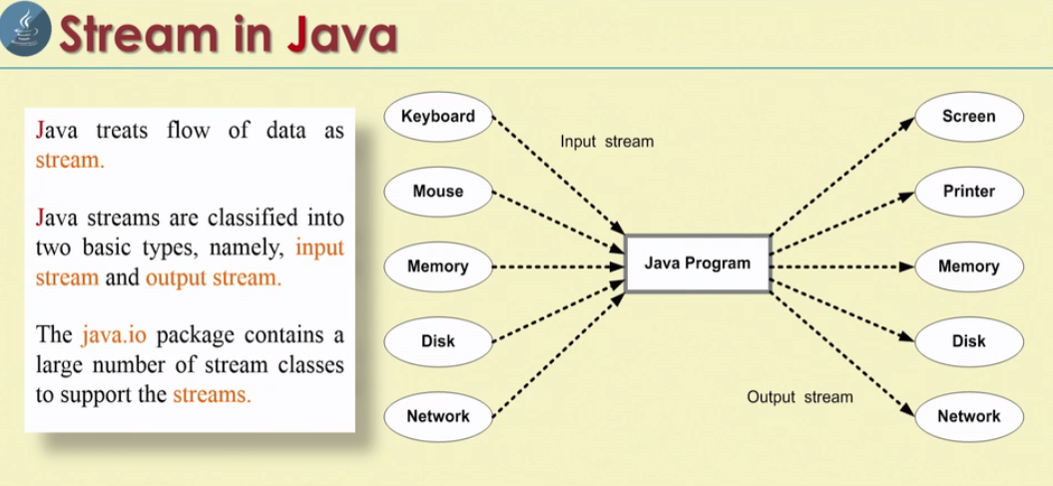
Advantage of stream concept
Streams are mainly useful to move data from one place to another place. This concept can be used to receive data from input device and send data to an output device.

Slide 5
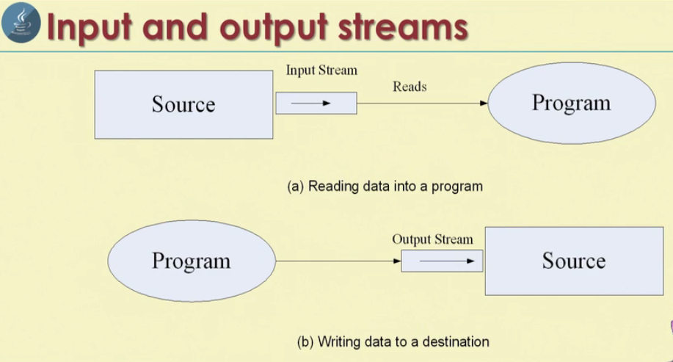

Slide 6
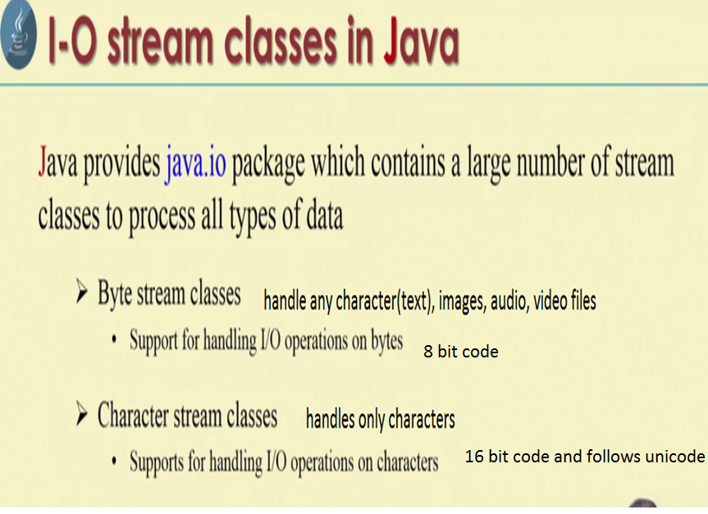

Slide 7
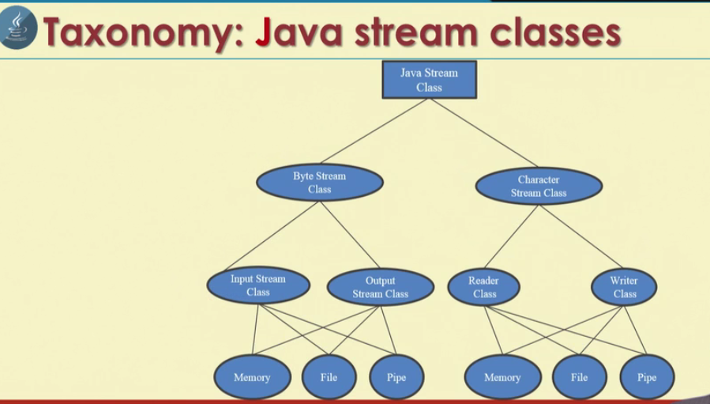

Slide 8
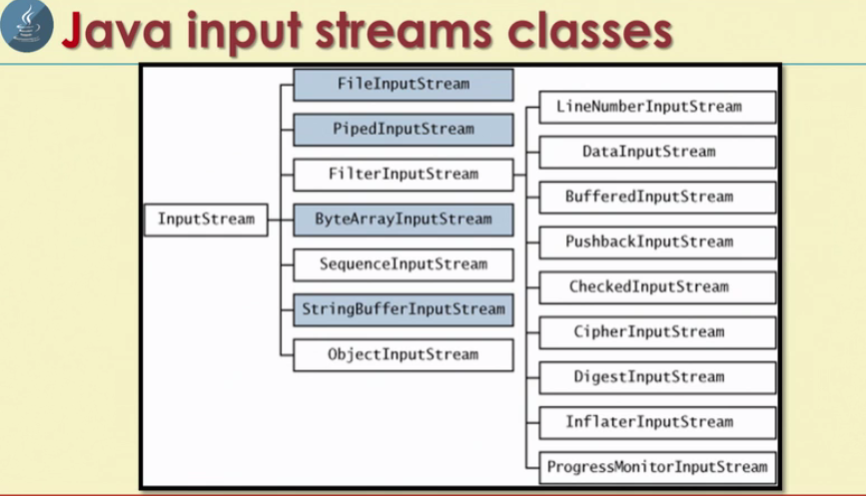

Slide 9
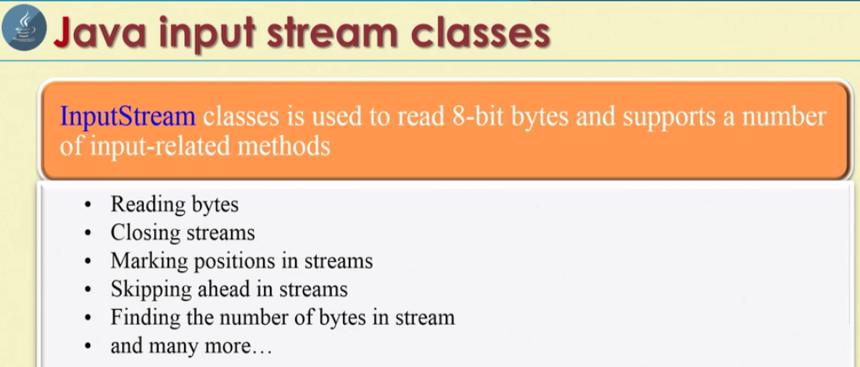

Slide 10
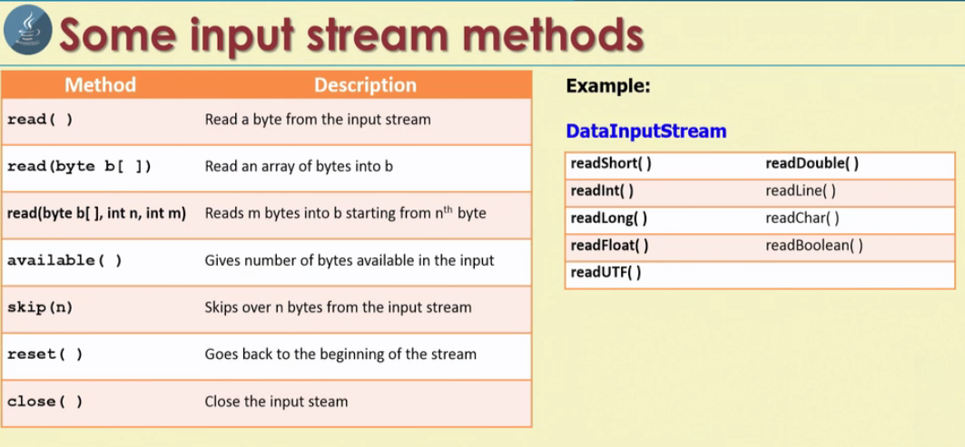

Slide 11
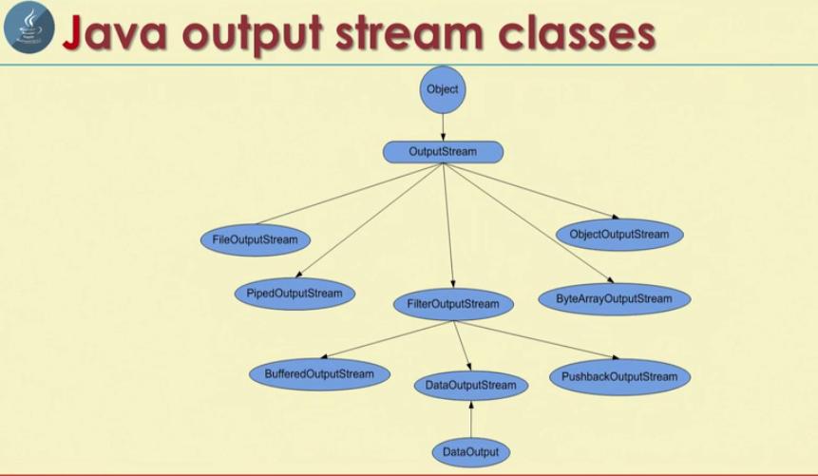

Slide 12
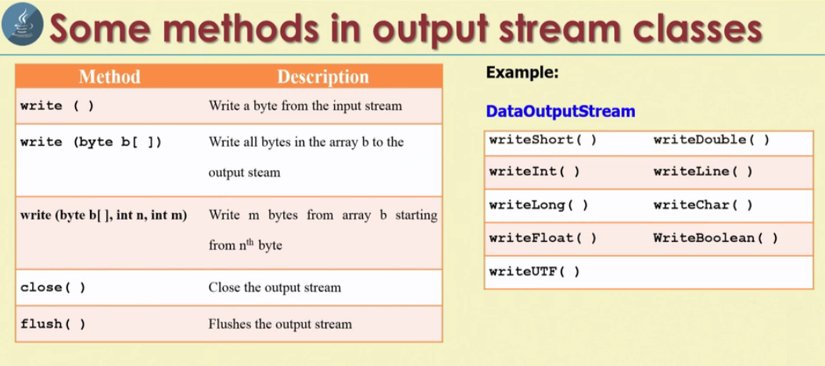

Slide 13
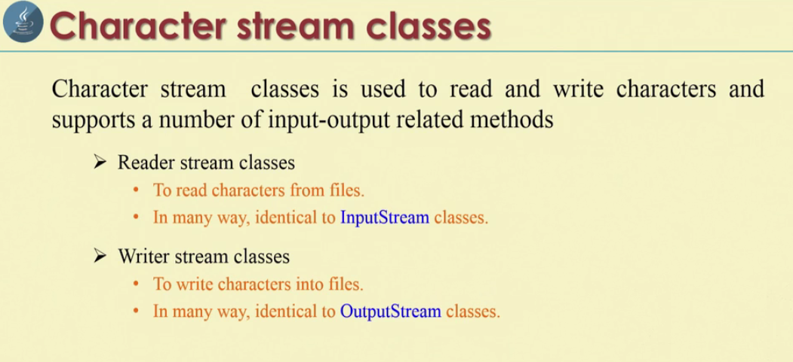

Slide 14
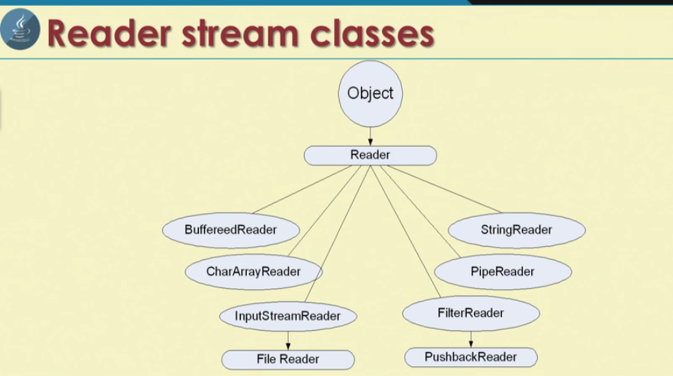

Slide 15
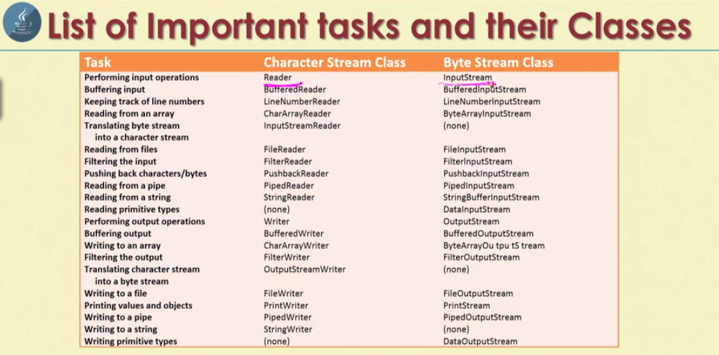

Slide 16
Creating a file using FileOutputStream
FileOutputStream belongs to byte stream and stores the data in the form of individual bytes.
It can used to create text files.
We know that file represents storage of data on the secondary storage media like hard disk.
The following steps to create a text file that stores some characters.
First we should read data from the keyboard and attach the keyboard object to some input stream.
DataInputStream dis= new DataInputStream(System.in);

Slide 17
Now attach a file where the data is to be stored to some output stream. Here we take the help of FileOutputStream which can send our data to file.
Attach the file mytext.txt.
FileOutputStream fout= new FileOutputStream("myfile.txt");
fout represents FileOutputStream object.
Next step is read data using DataInputStream and write into FileOutputStream
ch= (char)dis.read();// read one character into ch
fout.write(ch) // write ch into file.
Finally close the file after performing the operation.
fout.close();

Slide 18
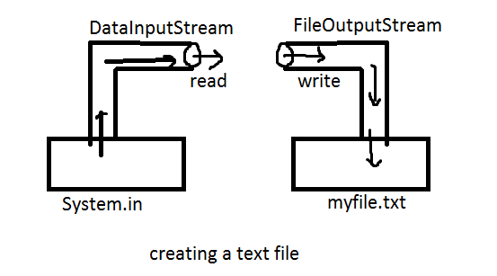
Creating a text file in diagrammatic representation

Slide 19
Creating file
package com.streams.edu;
import java.io.*;
public class CreateFile {
public static void main(String[] args) throws IOException{
// TODO Auto-generated method stub
// Attach keyboard to DataInputStream
DataInputStream dis= new DataInputStream(System.in);
//attach my file to FileOutputStream
FileOutputStream fout= new FileOutputStream("myfile.txt");
System.out.println("Enter text (@ to end):");
char ch;
// read the character from dis into ch. Then write them into fout.
// repeat this as long as read character is not '@'
while ((ch=(char)dis.read())!='@') {
fout.write(ch);
}
// close the file
fout.close();
}
}

Slide 20
Appending data to the file
package com.streams.edu;
import java.io.*;
public class CreateFile {
public static void main(String[] args) throws IOException{
// TODO Auto-generated method stub
// Attach keyboard to DataInputStream
DataInputStream dis= new DataInputStream(System.in);
//attach my file to FileOutputStream
FileOutputStream fout= new FileOutputStream("myfile.txt", true);
System.out.println("Enter text (@ to end):");
char ch;
// read the character from dis into ch. Then write them into fout.
// repeat this as long as read character is not '@'
while ((ch=(char)dis.read())!='@') {
fout.write(ch);
}
// close the file
fout.close();
}
}

Slide 21
We can give out own path to create file
package com.streams.edu;
import java.io.*;
public class CreateFile {
public static void main(String[] args) throws IOException{
// TODO Auto-generated method stub
// Attach keyboard to DataInputStream
DataInputStream dis= new DataInputStream(System.in);
//attach my file to FileOutputStream
FileOutputStream fout= new FileOutputStream("G:/Online_Core_Java/myfile.txt", true);
System.out.println("Enter text (@ to end):");
char ch;
// read the character from dis into ch. Then write them into fout.
// repeat this as long as read character is not '@'
while ((ch=(char)dis.read())!='@') {
fout.write(ch);
}
// close the file
fout.close();
}
}

Slide 22
Improving efficiency using BufferedOutputStream
fout.write(ch).
Let us estimate the time to read 100 characters from the keyboard and write into the file.
Let us assume that we can read data from keyboard into memory using DataOutputStream and it takes 1 sec to read and takes another second to write into the file by using FileOutputStream.
So for each character it is taking 2 sec 100*2=200sec
This is wasting a lot of time.
If Buffered classes are used, they provide a buffer(temporary block of memory) which is first filled with characters and then all the characters from buffer can be at once written in a file.

Slide 23
We can attach the FileOutputStream to BufferedOutputstream as :
BufferedOutputStream bout= new BufferedoutputStream(fout,1024);
Here the buffer size declared as 1024 bytes. If the buffer size is not mentioned then default size is 512 bytes.

Slide 24
Using BufferedOutputStream
package com.streams.edu;
import java.io.BufferedOutputStream;
import java.io.DataInputStream;
import java.io.FileOutputStream;
import java.io.IOException;
public class Createfile_Buffer {
public static void main(String[] args) throws IOException{
// TODO Auto-generated method stub
// Attach keyboard to DataInputStream
DataInputStream dis= new DataInputStream(System.in);
//attach my file to FileOutputStream
FileOutputStream fout= new FileOutputStream("G:/Online_Core_Java/myfile.txt", true);
BufferedOutputStream bout= new BufferedOutputStream(fout,1024);
System.out.println("Enter text (@ to end):");
char ch;
// read the character from dis into ch. Then write them into fout.
// repeat this as long as read character is not '@'
while ((ch=(char)dis.read( ))!='@') {
bout.write(ch);
}
// close the file
bout.close();
}
}

Slide 25
Reading Data from a File using FileInputStream
FileInputStream is a useful to read data from a file int the form of sequence of bytes.
It is possible to read the data from a text file using FileInputStream.
FileInputStream fin = new FileInputStream(“myfile.txt”);
This will enable us to read data from the file. Then, to read data from the file, we should read as:
ch=fin.read();
When the read() method reads all the characters from the file, it reaches the end of file. When there is no more data available to read further, the read() method returns -1.

Slide 26
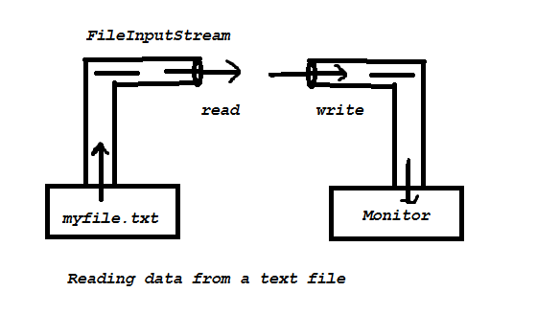
Then, we should attach the monitor to some output stream, for example, PrintStream, so that output stream will send data to the monitor.
For displaying the data, we can use System.out which is nothing but a PrintStream object
System.out.println(ch);
Finally, we can read data from the FileInputStream and write into System.out.

Slide 27
Reading Text file using FileInputStream
package com.streams.edu;
import java.io.*;
import java.nio.file.Path;
public class ReadFile {
public static void main(String[] args)throws IOException {
//attach the file to FileInputStream
FileInputStream fin= new FileInputStream("myfile.txt");
System.out.println("File Contents");
// read the character from the FileInputStream and write
// them to monitor. Repeat until the end of file.
int ch;
while((ch=fin.read())!=-1)
{
System.out.print((char)ch);
}
// close the file.
fin.close();
}
}

Slide 28
After few improvements
package com.streams.edu;
import java.io.*;
import java.nio.file.Path;
public class ReadFile {
public static void main(String[] args)throws IOException {
//attach the file to FileInputStream
BufferedReader br = new BufferedReader(new InputStreamReader(System.in));
System.out.println("Enter File name");
String fname=br.readLine();
FileInputStream fin=null;
// check if file exists are not.
try
{
fin= new FileInputStream(fname);
}catch(FileNotFoundException fe)
{
System.out.println("File not found");
return;
}
//attach fileinputstream to BufferedInputStream
BufferedInputStream bin = new BufferedInputStream(fin);
System.out.println("File Contents");
// read the character from the FileInputStream and write
// them to monitor. Repeat until the end of file.
int ch;
while((ch=bin.read())!=-1)
{
System.out.print((char)ch);
}
// close the file.
bin.close();
}
}

Slide 29
Creating a file using FileWriter.
FileWriter is useful to create a file by writing characters into it.
In this program we are taking a string from where the characters are read and written into a FileWriter, which is attached to a file named text.

